Slide 1


IDS 1721
Computing and Problem Solving for STEM
Chapter 06
Randomness

Slide 2
Randomness
Q) If a computer is predictable, how can it simulate random numbers?
Computers are inherently deterministic, so true randomness is challenging for them to generate.
Instead, they use random number generators, which are algorithms designed to produce sequences of numbers that mimic randomness.
This is precisely the case when we use the MATLAB pseudorandom number generators rand and randn.
We’ll estimate π by simulating a random dart-throwing “game” whose expected score relates to the area of a circular target. This is an instance of Monte Carlo simulation.

Slide 3
Generating Random Numbers
Some common functions to generate random numbers are:
rand() generates a single random number between 0 and 1.
rand(n) generates an n×n matrix
rand(m,n) generates an m×n matrix.
The numbers generated above are uniformly distributed (all outcomes are equally likely within a given range).
randi(maxValue) generates random integers between 1 and maxValue.
randi(maxValue, m, n) generates an m×n matrix of random integers between 1 and maxValue.

Slide 4
Exercise 1
Use the rand function to generate:
  A vector of 10 random numbers between 0 and 1.
  A 5x5 matrix of random numbers between 0 and 1.
Use the randi function to generate:
  A vector of 8 random integers between 1 and 100.
  A 4x4 matrix of random integers between 1 and 50.
Display the generated numbers.

Slide 5
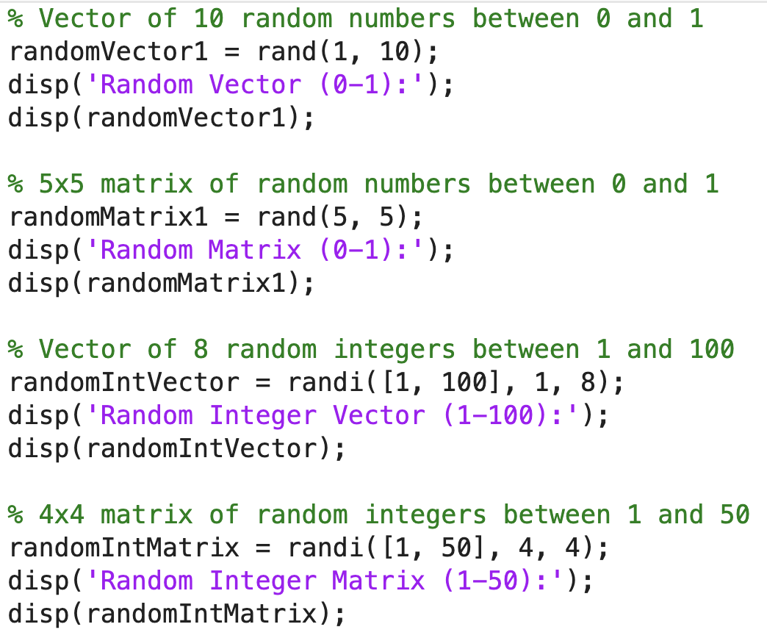

Slide 6
Seed
In MATLAB, a random seed is a starting point for generating a sequence of random numbers.
Setting the same random seed sets the initial state of MATLAB's random number generator, ensuring that any subsequent series of random numbers will be predictable and repeatable.
This is useful for reproducing the same sequence of random numbers, as in testing or data sampling.
MATLAB uses the rng function to set the random seed and control the type of random number generator.
Example:
rng(42); % Setting seed to 42
% Generates a fixed sequence of 5 random numbers
randomNumbers = rand(1, 5);
By using rng(42) again in the future, you’ll get the same sequence in randomNumbers.
Without setting a seed, MATLAB automatically initializes its random number generator based on the current time, producing different results each run.
Notes:
A dart is thrown at the target and lands randomly inside the square. We say that the dart is a “hit” if it lands inside the circular bullseye. This just means
that the landing coordinates (x,y) satisfy
x² + y² ≤ 1
If we throw n darts and n is a large number, then the fraction of darts that hit the bullseye
should approximate the ratio of the bullseye area to the square area, i.e.,
Write a script that simulates the throwing of 10,000 darts and displays the resulting π-
estimate. The darts should be evenly distributed across the square. What happens if the
darts are “aimed” at the origin? How does this affect the resulting estimate of π?

Slide 7
Exercise 2
Setting a Random Seed
Set the random seed to 21 using the rng function.
Generate and display a vector of 15 random numbers between 0 and 1.
Reset the random seed to 21 and generate the sequence again.
Verify if the two sequences are identical, demonstrating the concept of reproducibility.

Slide 8
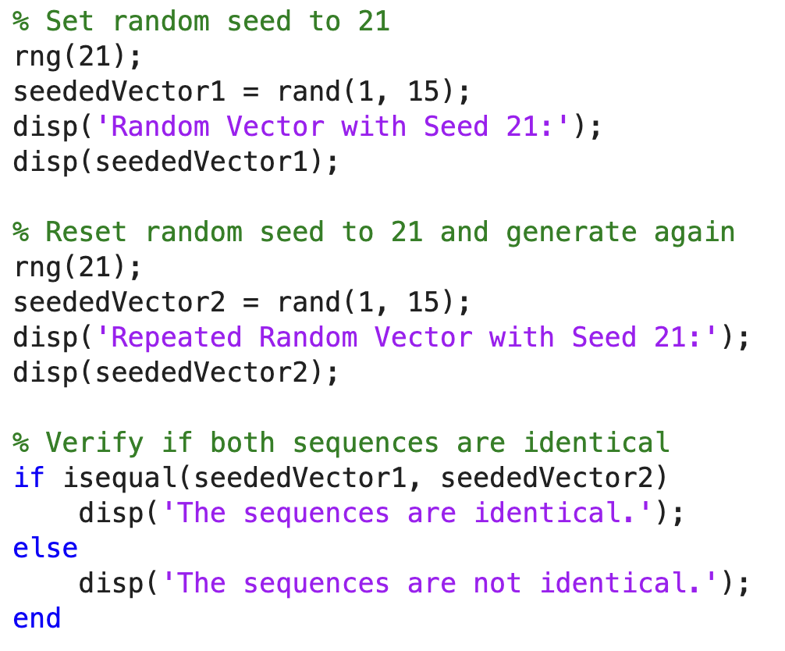

Slide 9
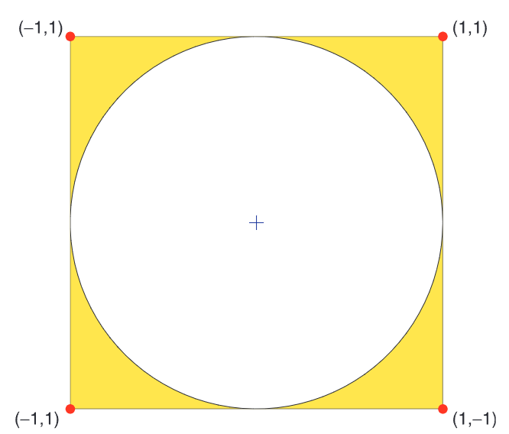



Exercise 3: Throw darts to approximate π
Write a script that simulates the throwing of 10,000 darts and displays the resulting π-estimate.
Consider a target that consists of a 2-by-2 square centered at the origin with a unit disk “bullseye.”
A dart is thrown at the target and lands randomly inside the square. A fraction of darts land inside the circle, and the ratio of the circle area to the square area is:
So, π can be estimated as:
Notes:
A dart is thrown at the target and lands randomly inside the square. We say that the dart is a “hit” if it lands inside the circular bullseye. This just means
that the landing coordinates (x,y) satisfy
x² + y² ≤ 1
If we throw n darts and n is a large number, then the fraction of darts that hit the bullseye
should approximate the ratio of the bullseye area to the square area, i.e.,
Write a script that simulates the throwing of 10,000 darts and displays the resulting π-
estimate. The darts should be evenly distributed across the square. What happens if the
darts are “aimed” at the origin? How does this affect the resulting estimate of π?

Slide 10
Problem Statement
Write a script that simulates the throwing of 10,000 darts and displays the resulting π-estimate. The darts should be evenly distributed across the square. What happens if the darts are “aimed” at the origin? How does this affect the resulting estimate of π?
Notes:
A dart is thrown at the target and lands randomly inside the square. We say that the dart is a “hit” if it lands inside the circular bullseye. This just means
that the landing coordinates (x,y) satisfy
x² + y² ≤ 1
If we throw n darts and n is a large number, then the fraction of darts that hit the bullseye
should approximate the ratio of the bullseye area to the square area, i.e.,
Write a script that simulates the throwing of 10,000 darts and displays the resulting π-
estimate. The darts should be evenly distributed across the square. What happens if the
darts are “aimed” at the origin? How does this affect the resulting estimate of π?

Slide 11
Program Development
We need to simulate random numbers for dart-throwing: we’ll use the rand function for random events.
We need to see if it lands inside the circle to count the hits: use the circle equation to determine if the dart is inside or not
Then, for a large number of throws (n) we can estimate π

Slide 12
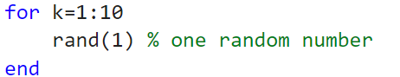
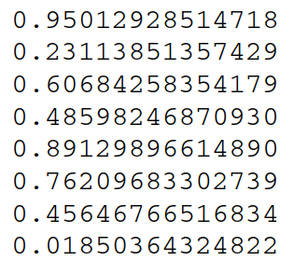
Program Development: rand function
The rand function can be used to simulate random events. If n is an initialized integer, then the script
displays a sequence of numbers with the properties that (a) each number is in between zero and one and (b) they are random

Slide 13
Program Development: rand function
r = rand(1) produces a single random number
The function rand can be used to return a vector of random numbers. If n is initialized to a positive integer, then
r = rand(n,1)
creates a column n -vector of random numbers.
To get a better sense of the distribution of the values, let us produce a bar graph that shows the fraction of rand values that fall within each decile. That is, how many rand-generated values fall between 0 and 0.1, 0.1 and 0.2, etc?
Notes:
The logic behind this approximation is the same as the logic behind (6.1). If we regard an r-value in the “target” interval [L,R] as a “hit,” then
The function rand can be used to return a vector of random numbers. If n is initialized to a positive integer, then
r = rand(n,1)
creates a column n-vector of random numbers.

Slide 14
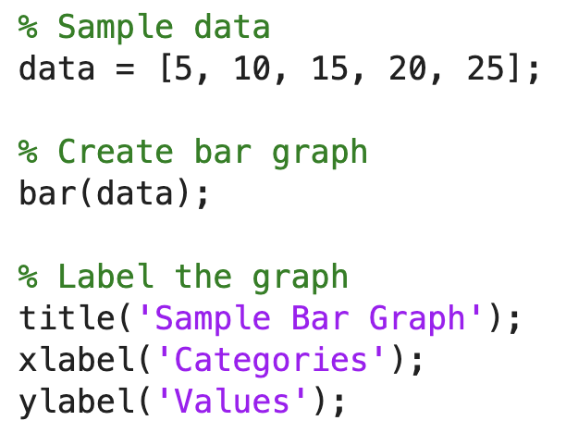
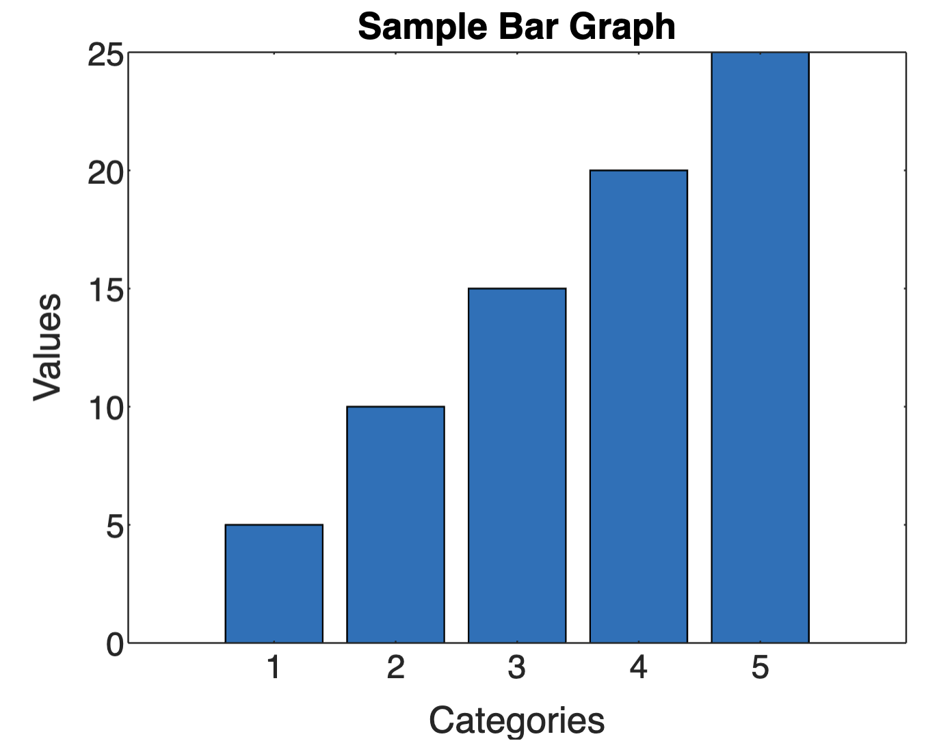
Bar graph
In MATLAB, you can create a bar graph using the bar function, which is designed to plot discrete data as rectangular bars.
Steps:
Define the data you want to display in the bar graph.
Pass the data to bar to generate the graph.

Slide 15
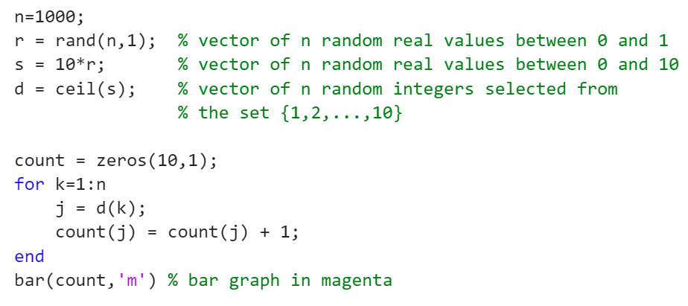
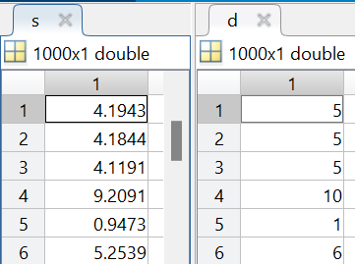
Program Development: rand function
The rand function allows you to specify the number of random values to produce. Let n be a (large) positive integer and consider the following fragment
Notes:
Having established d, all we have to do is count the number in each decile and then “hand over the results” to the built-in function bar, which draws a bar graph
One can anticipate that the relative discrepancy between the bar heights
diminishes as n increases.

Slide 16
Program Development: rand function
One can anticipate that the relative discrepancy between the bar heights diminishes as n increases.
N = 1000
N = 10,000
N = 100,000
N = 1,000,000
Notes:
Having established d, all we have to do is count the number in each decile and then “hand over the results” to the built-in function bar, which draws a bar graph
One can anticipate that the relative discrepancy between the bar heights
diminishes as n increases.

Slide 17
Program Development: rand function
So, as the name suggests the uniform distribution of the rand() function helps us produce uniformly spread out numbers in the interval of (0,1).
If we use the following commands,
x = rand(100,1)
y = rand(100,1)
then (x,y) is a collection of the coordinates of 100 uniformly spread out points in the square (0,1)X(0,1).
How do we modify this to get the points in the square (-1,1)X(-1,1)?

Slide 18
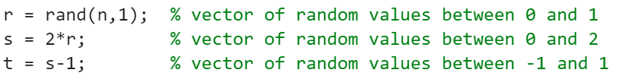
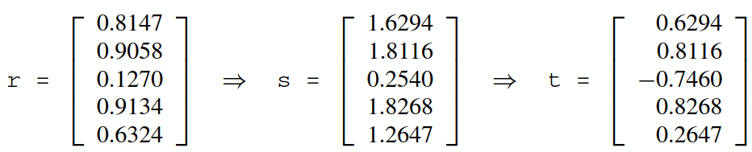
Program Development: rand function
We can use rand to generate random values across a specified interval like (-1,1) by scaling and translating:
For example:

Slide 19
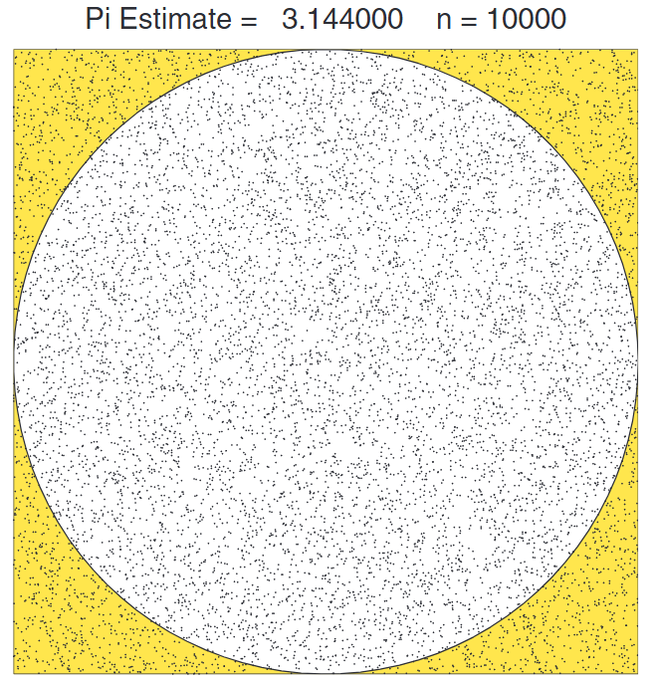
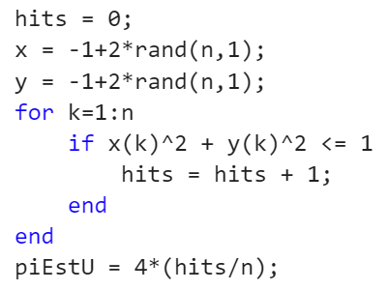

Program Development
Thus, the fragment
simulates the throwing of n darts, counts the number of “hits,” and estimates $$ accordingly.

Slide 20
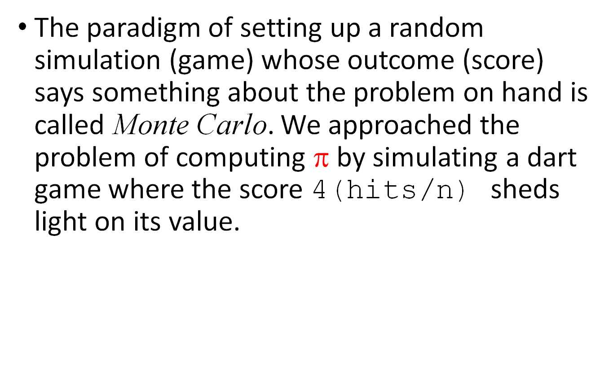
Program Development
The paradigm of setting up a random simulation (game) whose outcome (score) says something about the problem on hand is called Monte Carlo. We approached the problem of computing $$ by simulating a dart game where the score 4(hits/n) sheds light on its value.
Monte Carlo methods, or Monte Carlo experiments, are a broad class of computational algorithms that rely on repeated random sampling to obtain numerical results. The underlying concept is to use randomness to solve problems that might be deterministic in principle.
Notes:
Monte Carlo method – Wikipedia
Monte Carlo methods, or Monte Carlo experiments, are a broad class of computational algorithms that rely on repeated random sampling to obtain numerical results. The underlying concept is to use randomness to solve problems that might be deterministic in principle. The name comes from the Monte Carlo Casino in Monaco, where the primary developer of the method, physicist Stanislaw Ulam, was inspired by his uncle's gambling habits.

Slide 21
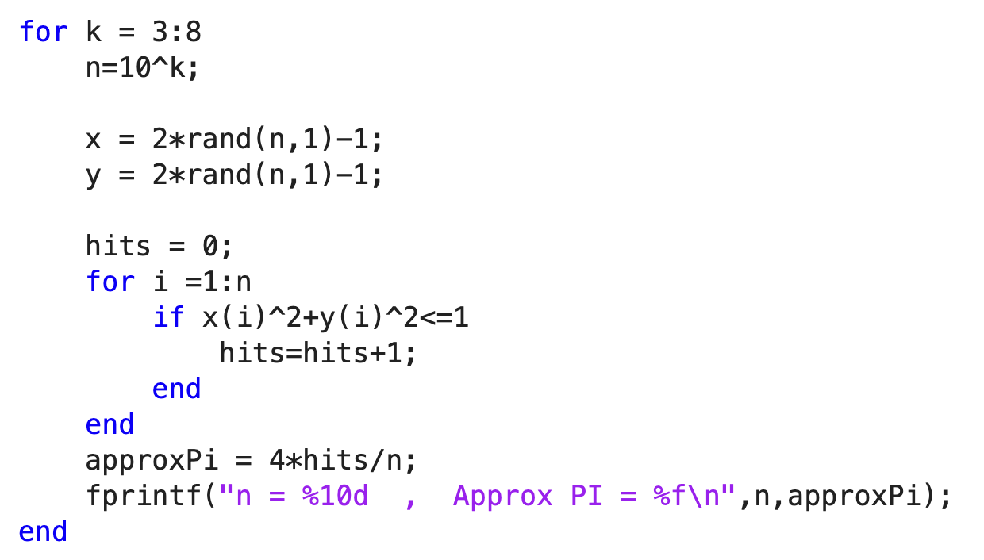
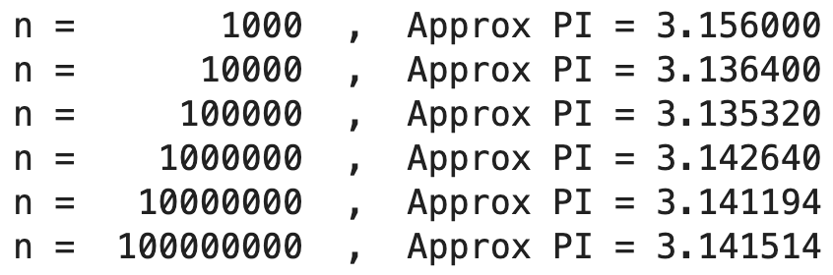
Let's try different values of n

